Slide 1
English/Language Arts
Common Core Standards- ELA 6
The standards establish guidelines for English language arts (ELA) as well as for literacy in history/social studies, science, and technical subjects. Because students must learn to read, write, speak, listen, and use language effectively in a variety of content areas, the standards promote the literacy skills and concepts required for college and career readiness in multiple disciplines.
http://www.corestandards.org/ELA-Literacy/

Slide 2
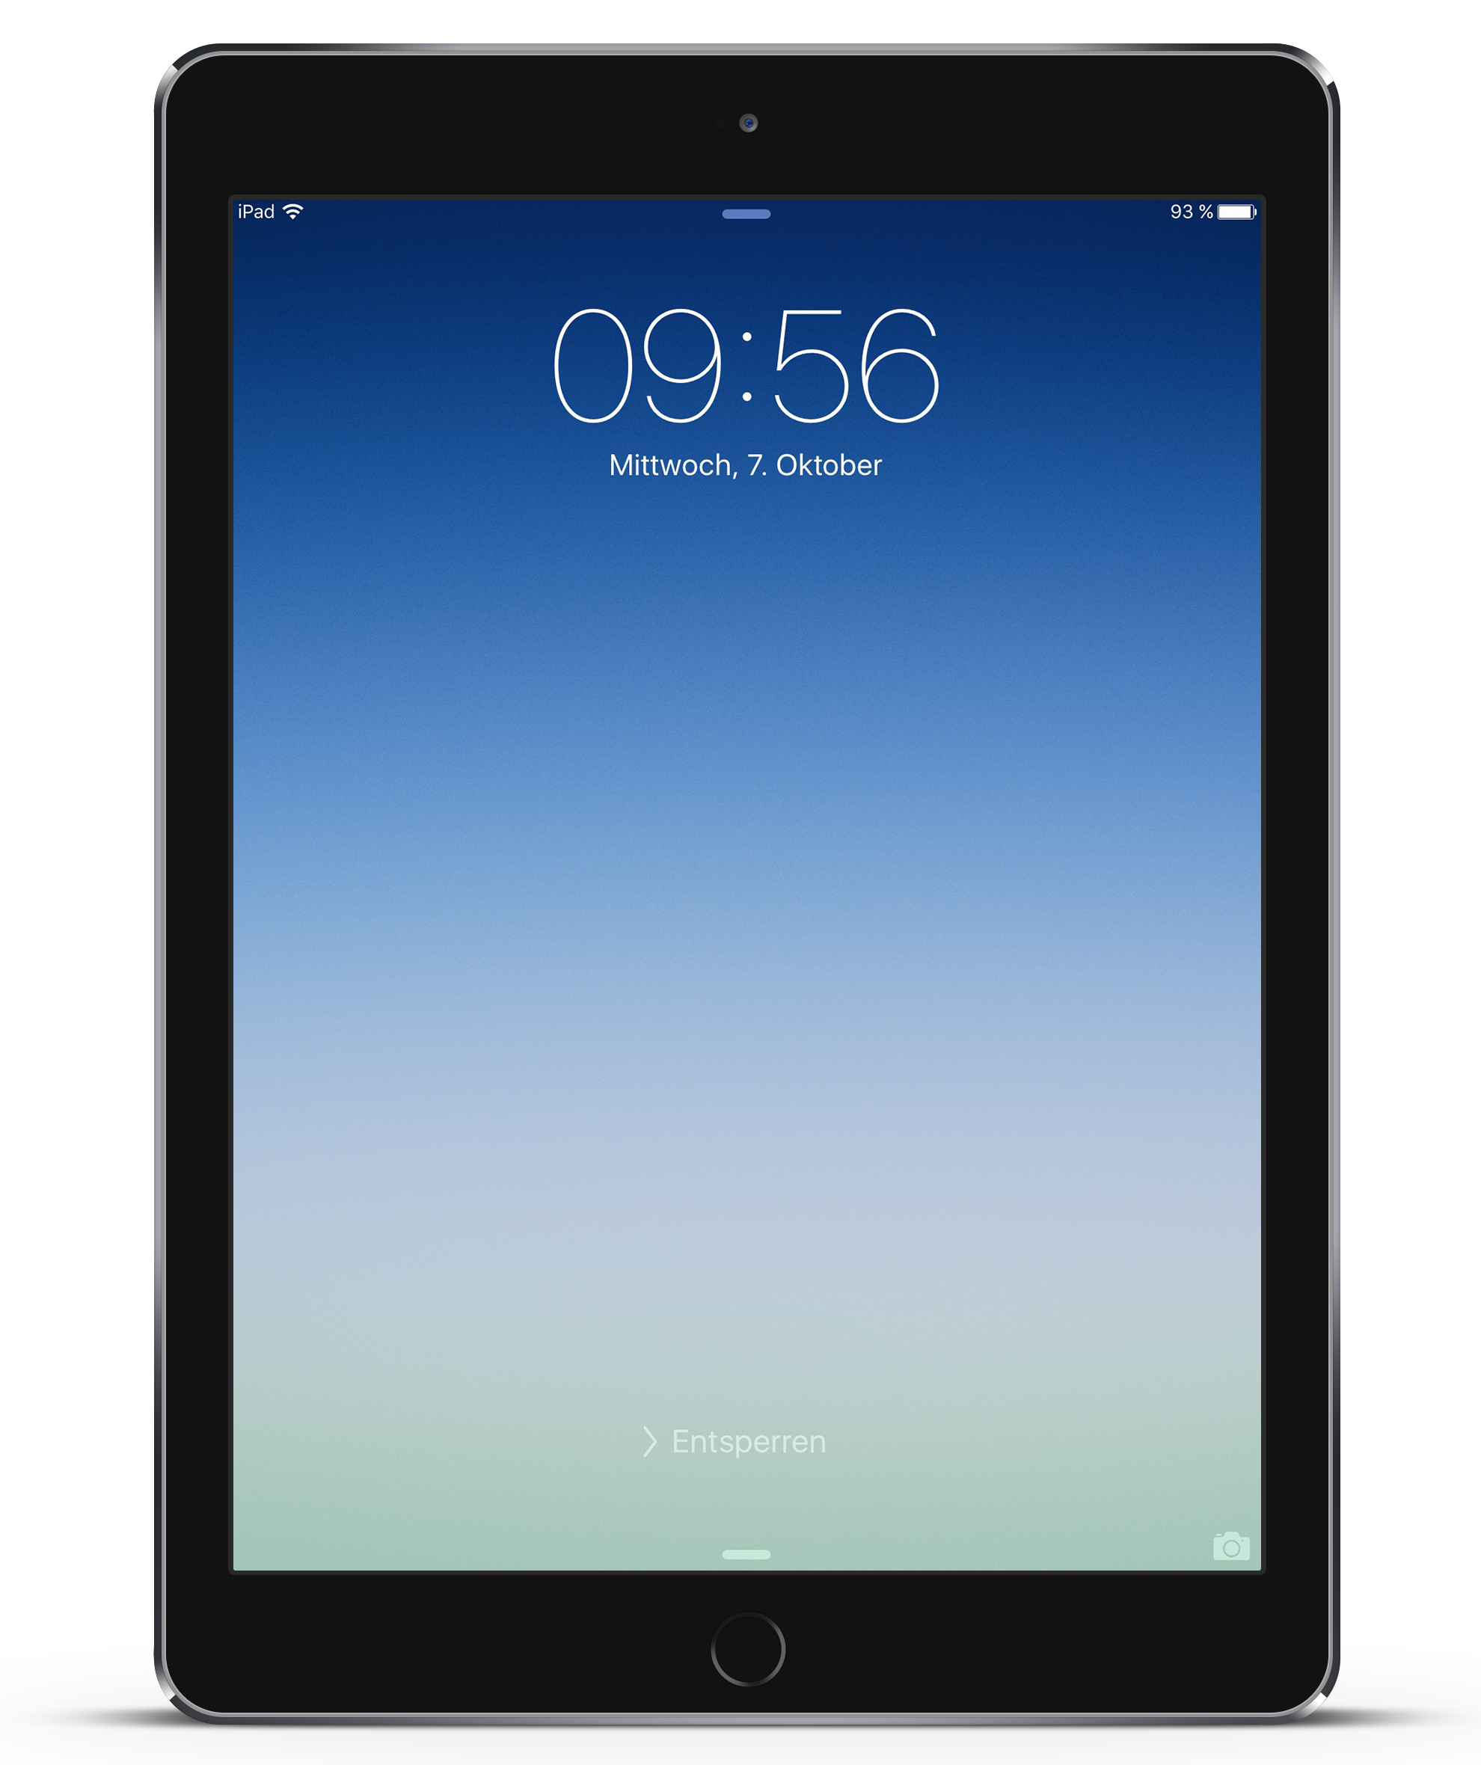
Reading (Continued)
Reading books for Literature Circles:
Classroom sets
Book requirements (By September 14th):
I am Malala (Young Readers Edition)By Malala Yousafzai
The Circuit Francisco Jimenez
I will be placing a Scholastic Book order form next week if you wish to purchase them through Scholastic. Suggestion: by them on Amazon.
AR Books:
Each student is required to have an AR book with them at all times.

Slide 3
Math Foundations
*This course is tailored for the student who needs additional arithmetic review while learning new concepts and skills in the areas of algebra, geometry, and data analysis & probability.
*Problem solving strategies are interwoven throughout the course.
*Topics are presented in a variety of ways, at a slower pace, in order to accommodate different learning styles.
*Students who complete this course with an 75% or better are expected to advance to Math 6.

Slide 4
Grading Scale
Standards-based formative and summative assessments determine a student’s level of mastery. The levels of performance,below, taken from the California State Standards, are presented with a short descriptor and the corresponding grade (A-F):
A​ - Advanced: student demonstrates an in-depth understanding of standards and is able to broadly apply the knowledge and skills of standards.
B ​- Proficient: student demonstrates a complete understanding of the standards and has some ability to apply the knowledge and skills of standards.
C​ - Basic: student demonstrates a functional understanding of the knowledge and skills of the standards.
D​ - Below Basic:​ student demonstrates a limited understanding of the knowledge and skills of the standards.
F​ - Far Below Basic: student demonstrates a lack of understanding of the knowledge and skills of the standards. All students in Grades 1-8 receive a progress report at least once each quarter with a second progress report issued for students who have fallen to a C- or below in a subject. Progress Reports may or may not have a letter grade but may use a check system.
Los Angeles Archdiocese
Grading Scale
A 95.5 -l00
A- 91.5-95
B+ 89.5-91
B 86.5-89
B- 84.5-86
C+ 79.5-84
C 74.5-79
C- 69.5-74
D 64.5-69
F 64 and below

Slide 5
Homework/Project Policy
When a project or assignment is not turned in on the due date, the next day the assignment/project receives half (1/2) credit and the following day no(0) credit.
What is important and required is that the assignment be completed.
● Parents are notified via GRADELINK
● In case of absence, all class/homework must be made up after returning to school. If a student is absent one day, then they have one day to make up the work, etc. It is the student’s and/or parent’s responsibility to acquire the make up work. Work not completed within this period will be given a zero grade, unless there are extenuating circumstances.
● Students who take vacations are responsible for making up all work within the guidelines provided by the teacher. Parents need to send a letter to the Principal and the teacher at least one week in advance of a trip so that plans can be made for makeup work.

Slide 6
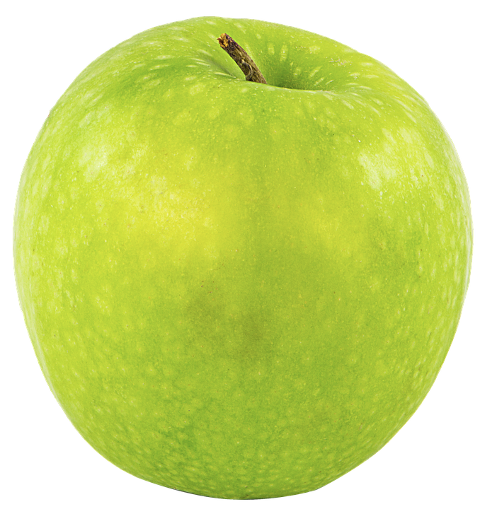
Teacher and Student Responsibilities
My Responsibilities as a Teacher:
To provide you with respect and care as an individual.
To provide you an orderly classroom environment.
To provide the necessary discipline.
To provide the necessary motivation.
To teach the required content.
Your Responsibility as a Student:
To treat me with respect and care as an individual.
To attend class regularly and punctually.
To be cooperative and not disruptive.
To study and complete your work (Success=Work)
To learn and master the required content.

Slide 7
Contact Information
Email Address: bponce@sggknights.org
Website: http://msponce6thknights.weebly.com
School Phone Number:(562) 941-0115

Slide 8
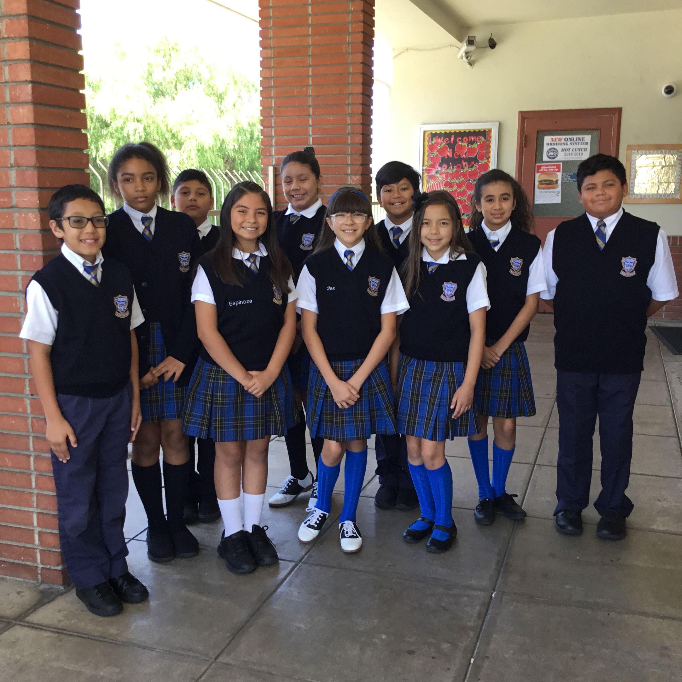
Thank you, Parents.

